Slide 1




Lesson 1: Orientation and Overview
Introduction to computation with python
Haihua Chen
Assistant Professor, Data Science
9402688589
Haihua.chen@unt.edu

Slide 2

Agenda
1
What and why is Python?
2
Natural Language Processing?
3
How to begin?
4
About the course

Slide 3
1
What and Why is Python?

Slide 4
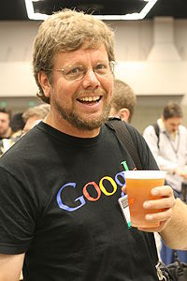

1.1. What is Python?
It is an open-source programming language
Created by Guido van Rossum in 1989
First version released in 1991
Now 3.12.5 / 7 August 2024

Slide 5


1.2. Why is Python?
Very easy to use
Let you work quickly
Integrate systems more effectively
One of the most popular programming languages in the planet
Notes:
https://pypi.org/

Slide 6
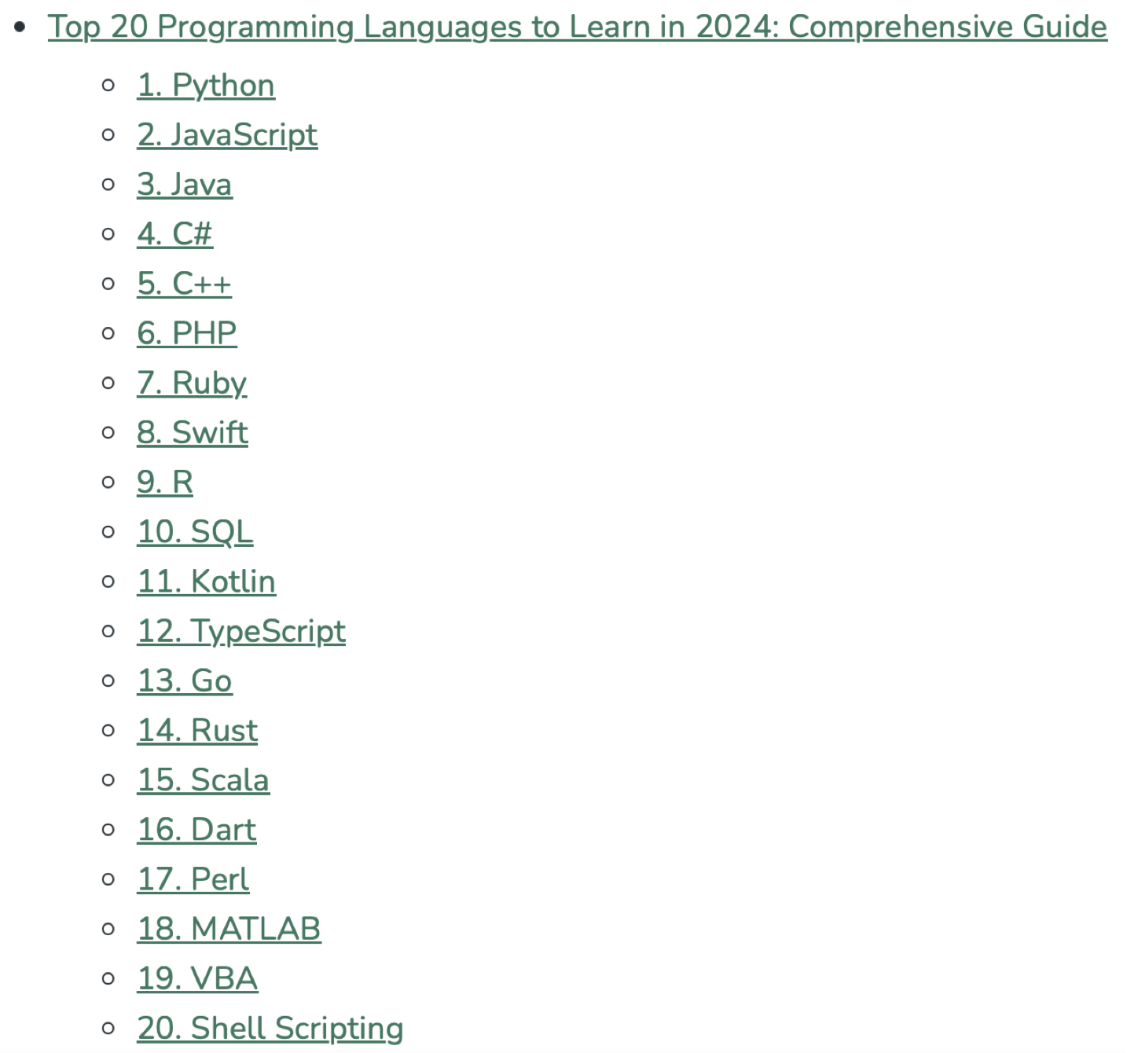
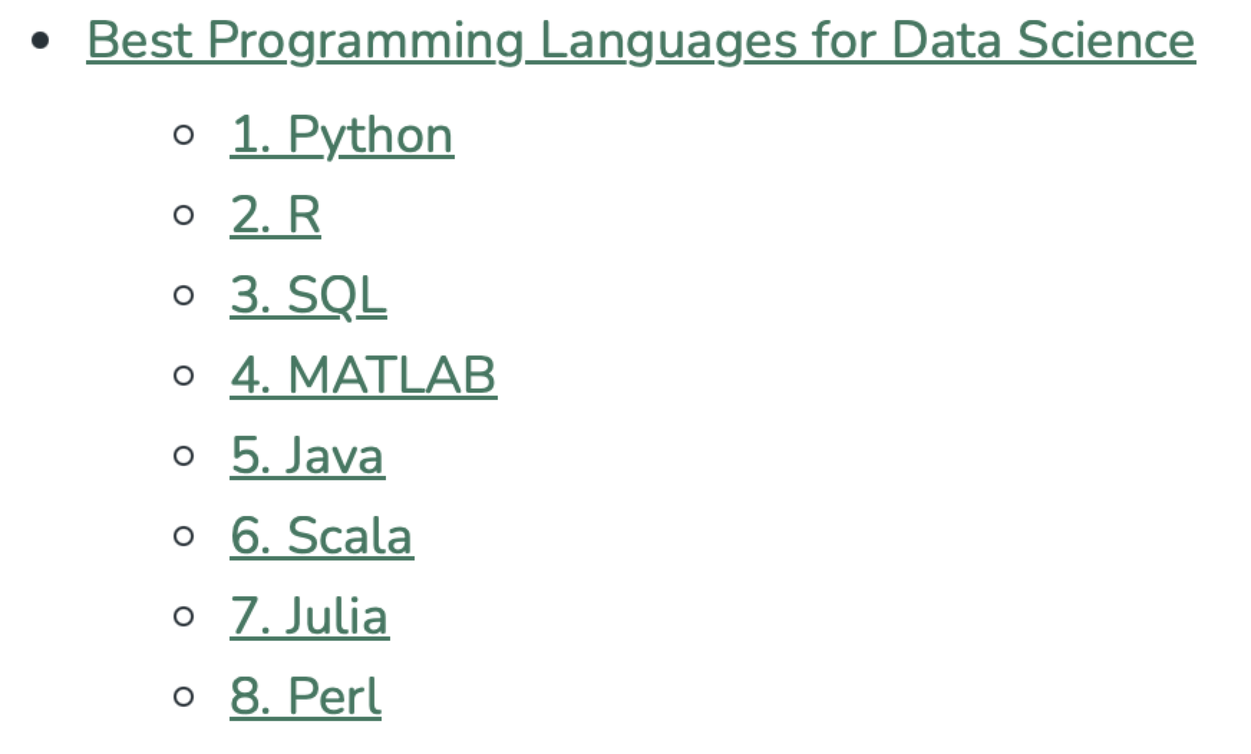
The Top Programming Languages 2024
Source: https://www.geeksforgeeks.org/top-programming-languages/
Notes:
For ranking, we took into account several key factors when ranking the top programming languages out in 2024:
Popularity: This aspect relates to how much a language is adopted and used across industries. As metrics for popularity, we used the developer survey on Stack Overflow and data available from different repositories on GitHub.
Job Demand: Reflects the existence and future demand for language professionals. This factor was analyzed using job boards and industry reports.
Versatility: Versatility means the breadth of application Use Cases a language would be able to cover. Versatility was assessed according to how the language did in domains such as web development, mobile development, data science, and many more.
Community Support: The community support behind a given language in terms of available resources, developer communities, or support forums. Community support was examined by the number of tutorials, documentation, and active users involved in contributing to the ecosystem around the language.
Future Trends: Given rising technologies and trends in the industry that indicate the language’s future growth in relevance by 2025.

Slide 7


1.3. Why is Python?--Area
Data
Analysis
Scientific
Calculation
Web
Crawler
Artificial
Intelligence
Python
Web
Development

Slide 8

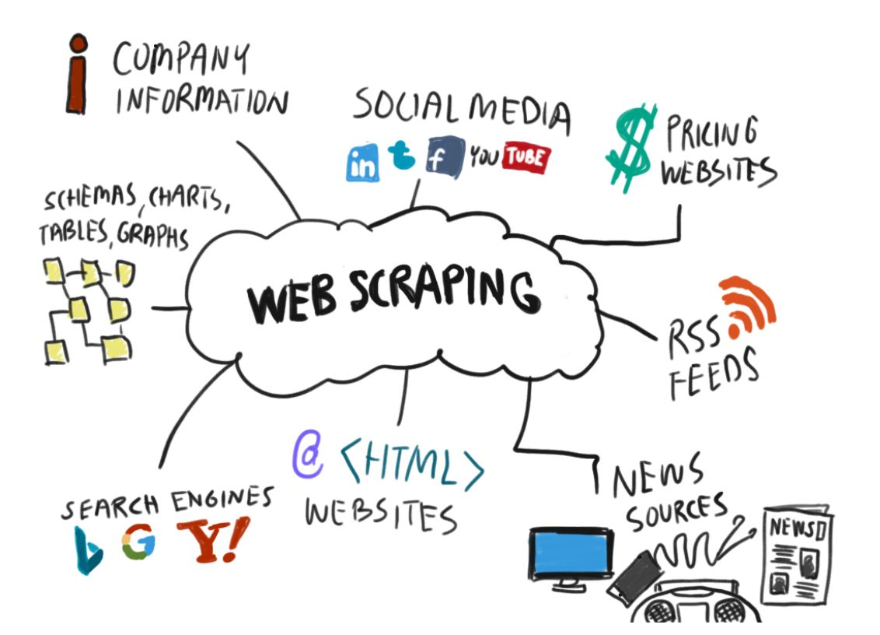
Web Crawler
Scrapy
Source: https://www.datasciencecentral.com/what-is-web-scraping-and-how-does-it-work/

Slide 9
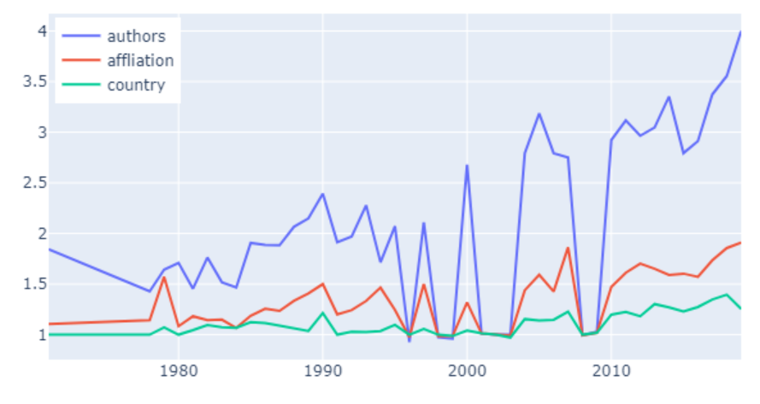
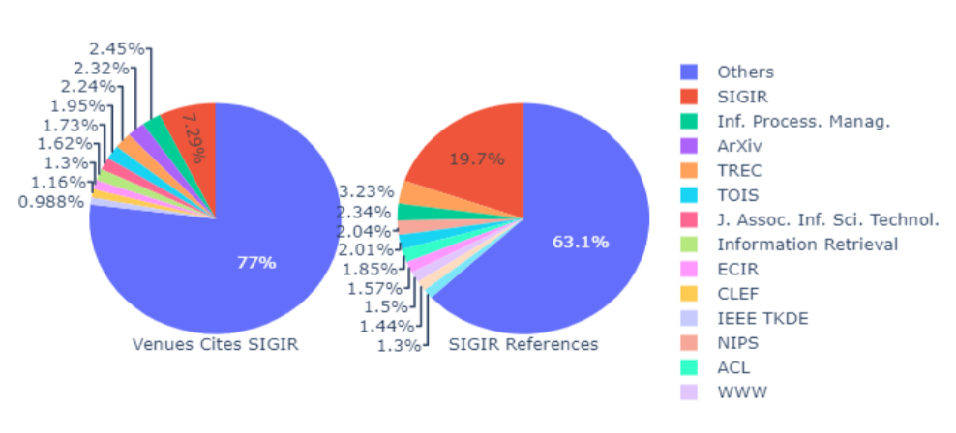
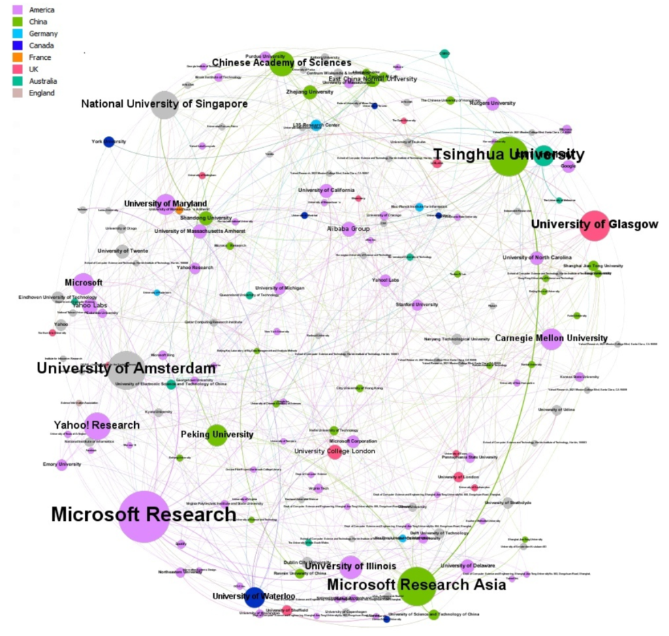
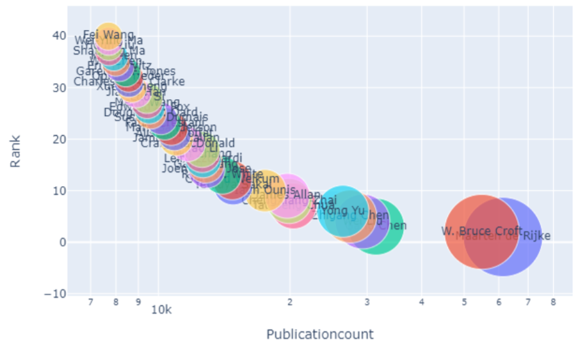
Data Analysis
NumPy，Pandas，Matplotlib

Slide 10
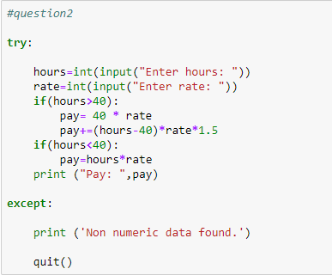
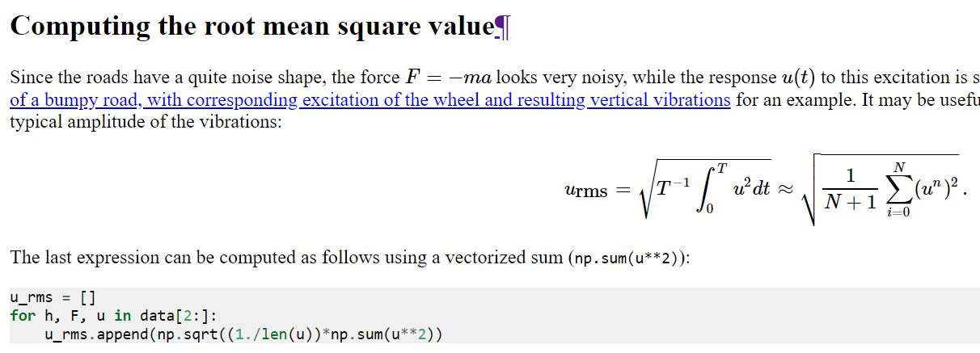
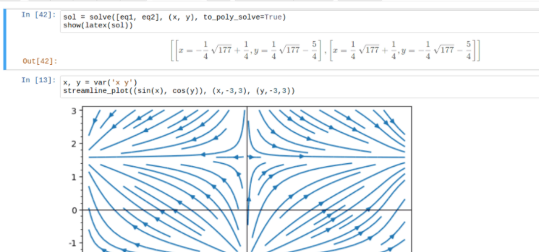
Scientific Calculation
NumPy，SciPy，BioPython

Slide 11
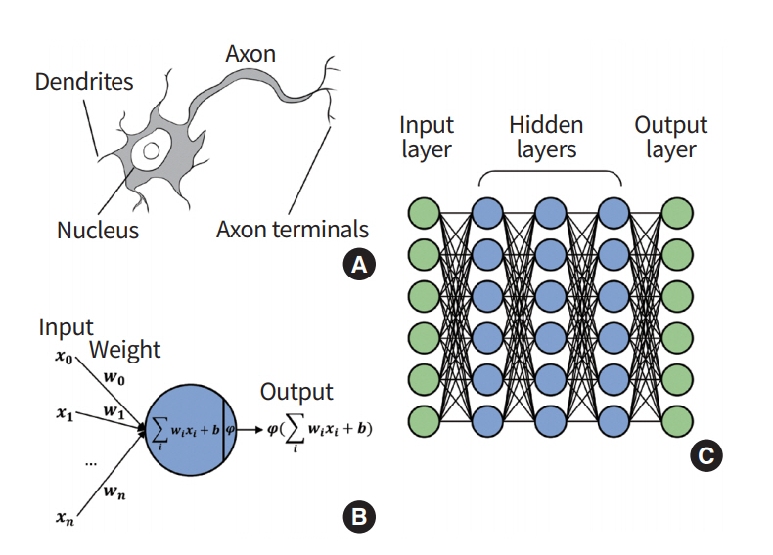
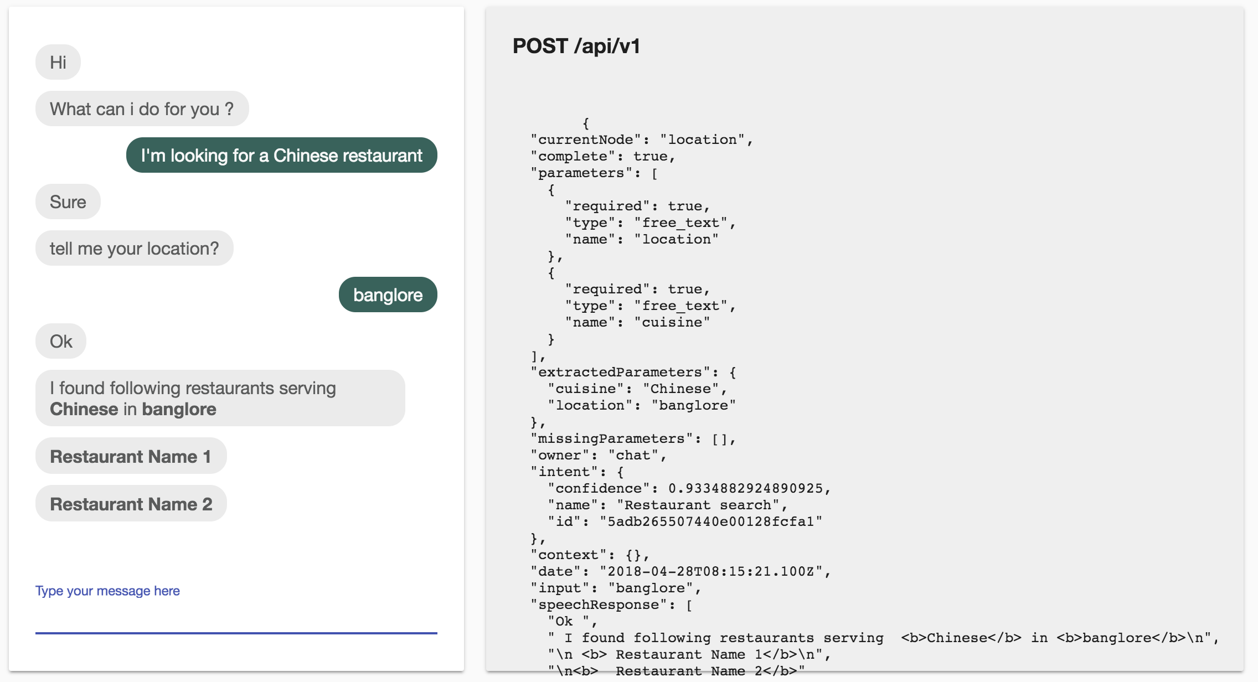
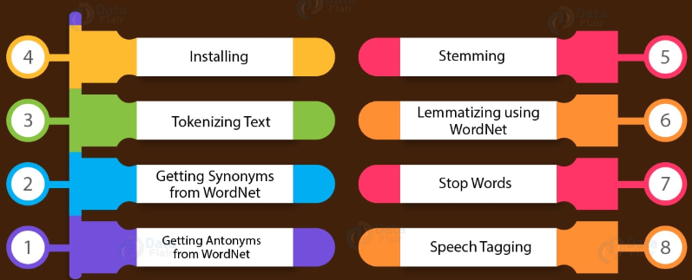
Artificial Intelligence
Scikit-learn，NLTK, Keras, TensorFlow, PyTorch

Slide 12
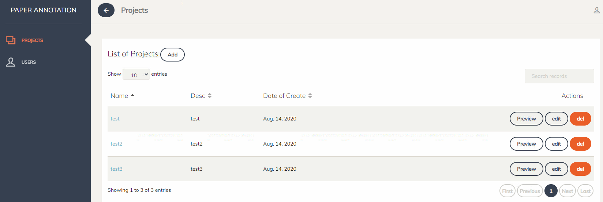
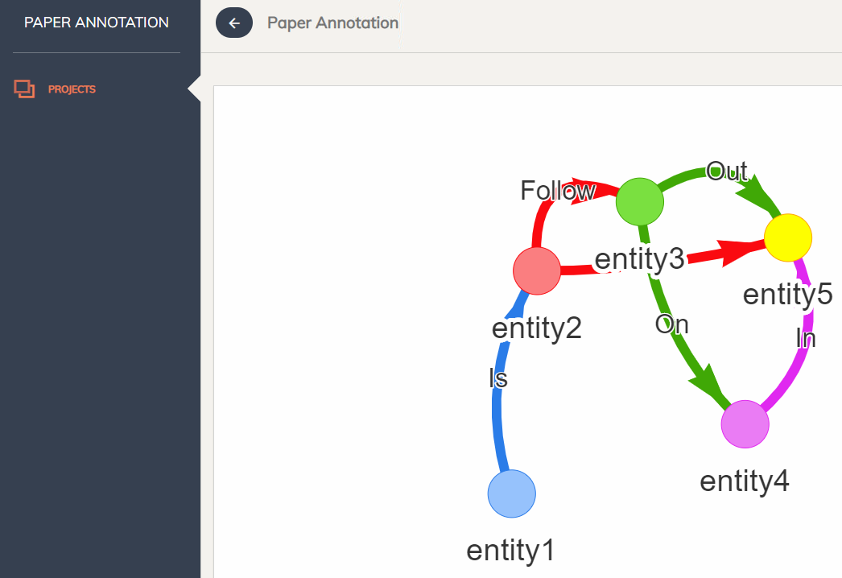
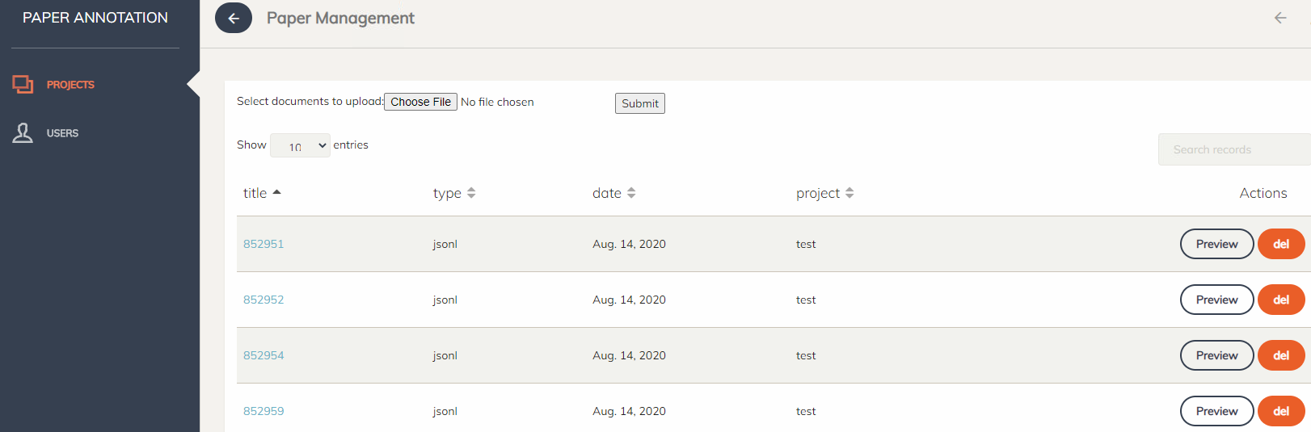
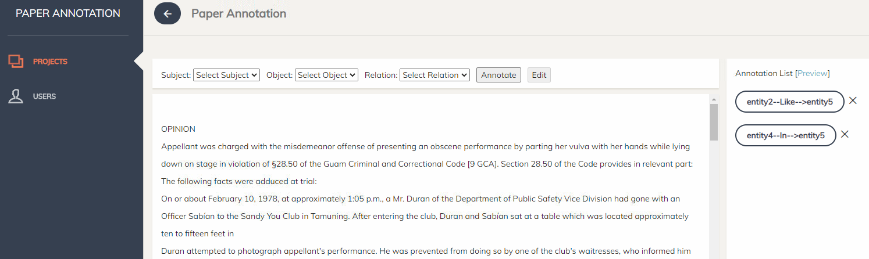
Web Development
Django，Flask, Tornado

Slide 13
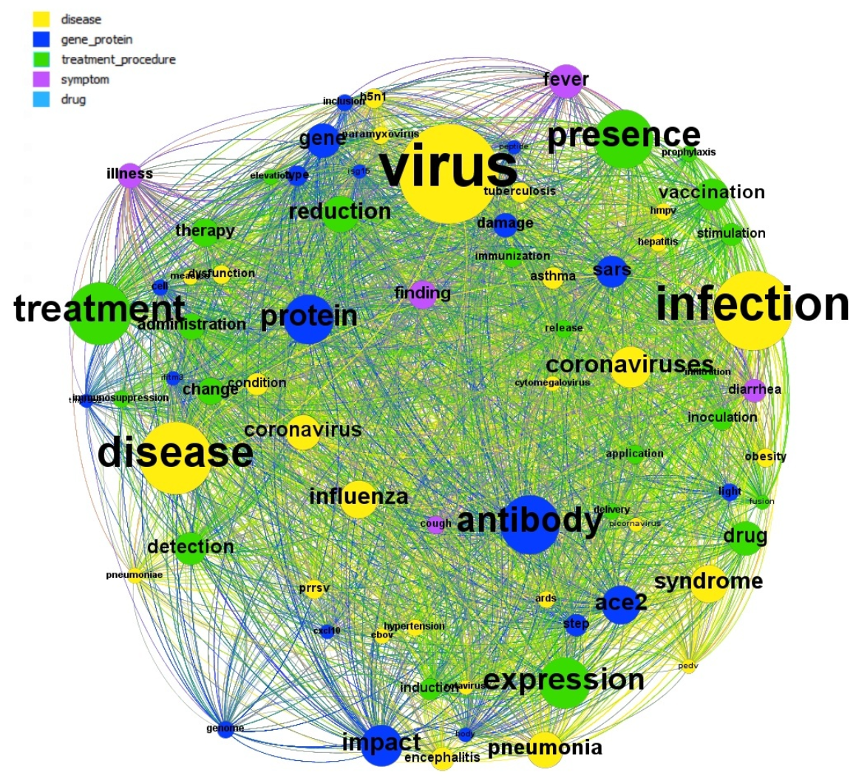
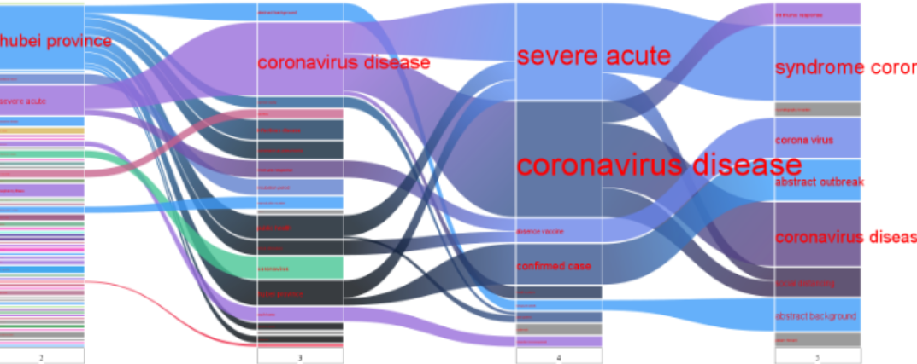
Visualization
Matplotlib

Slide 14
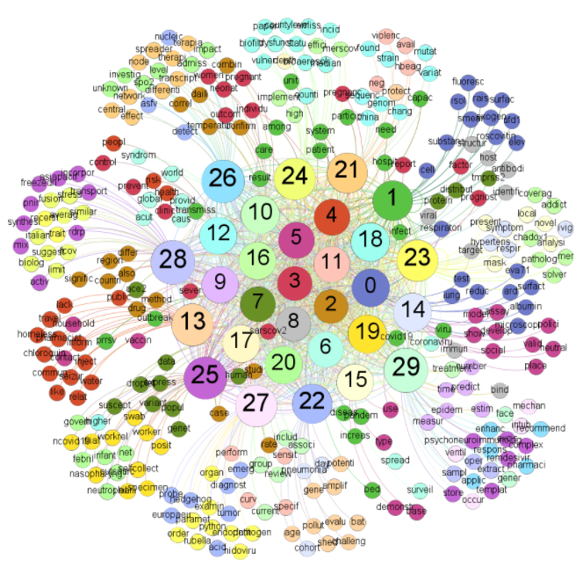
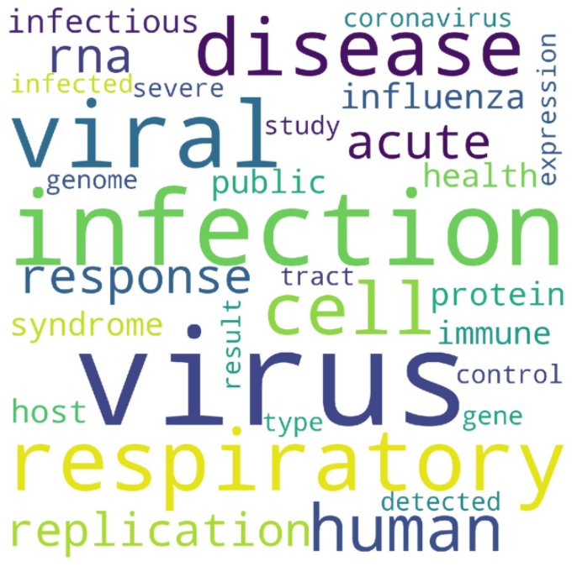
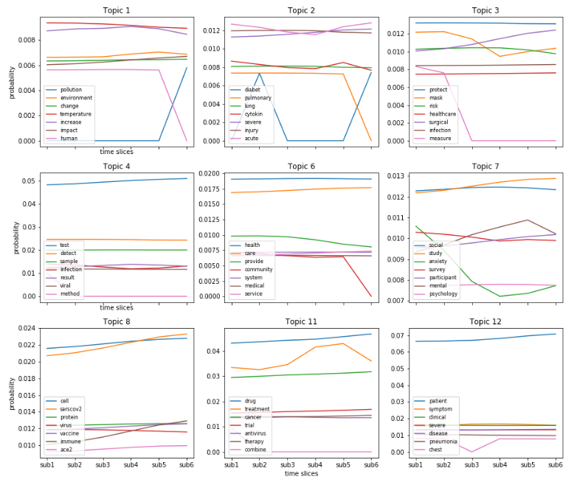
Text Mining
NLP, topic modeling

Slide 15












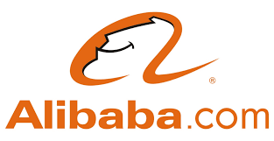




Who is using Python？
https://www.python.org/about/success/

Slide 16
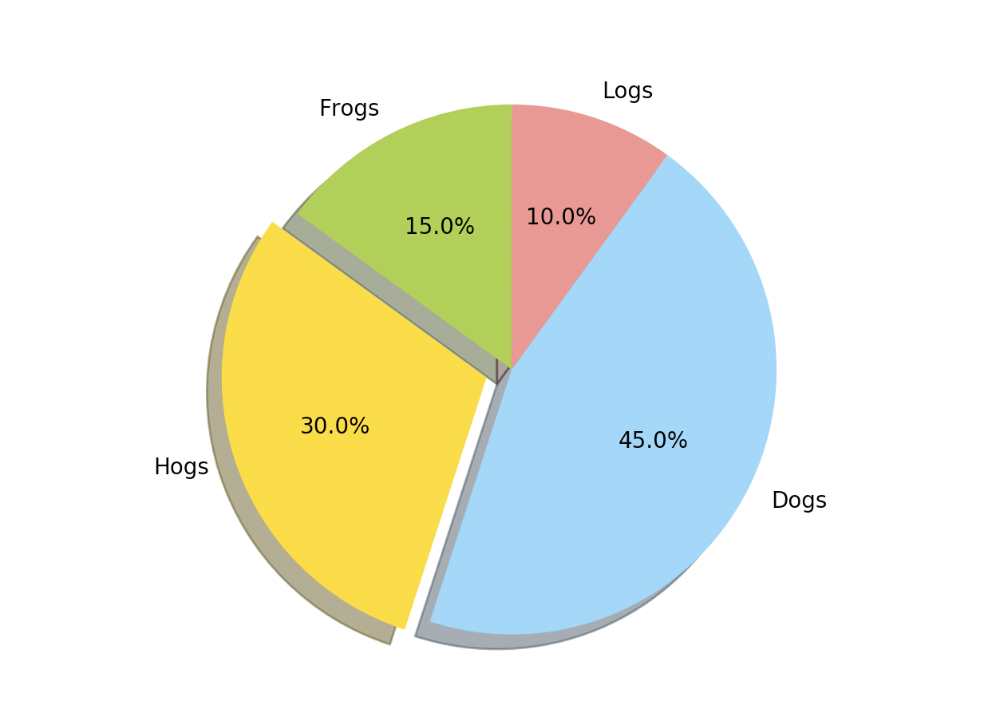
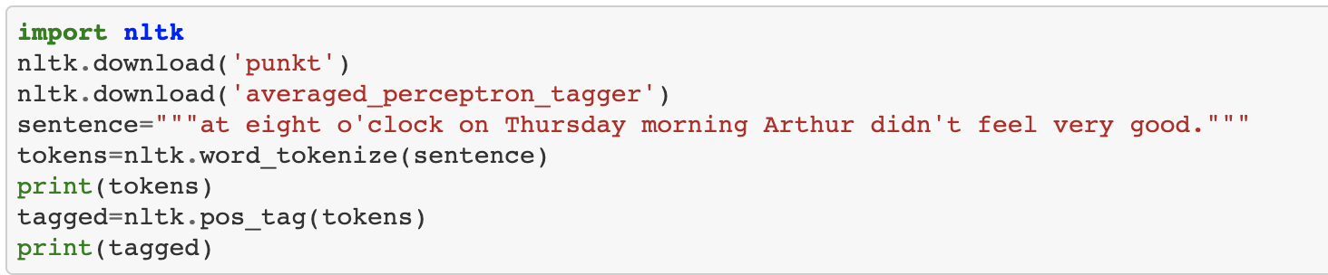
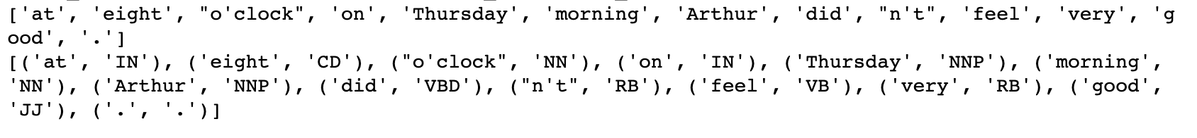
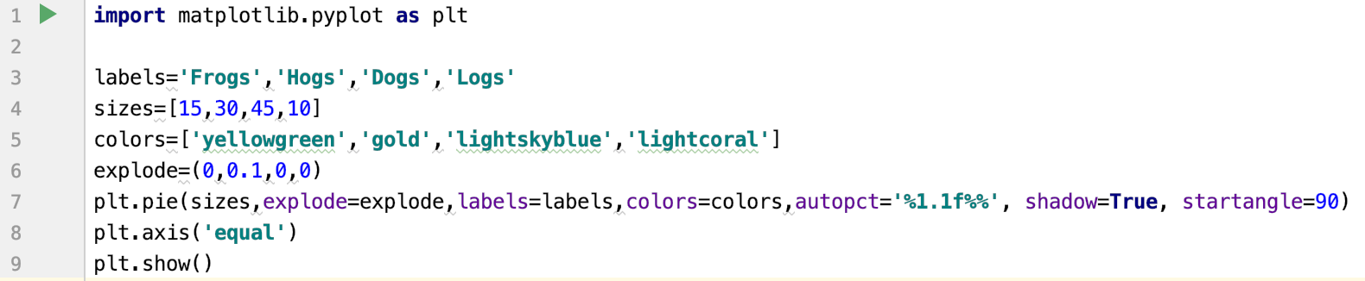
Coding is never so easy like this…..

Slide 17
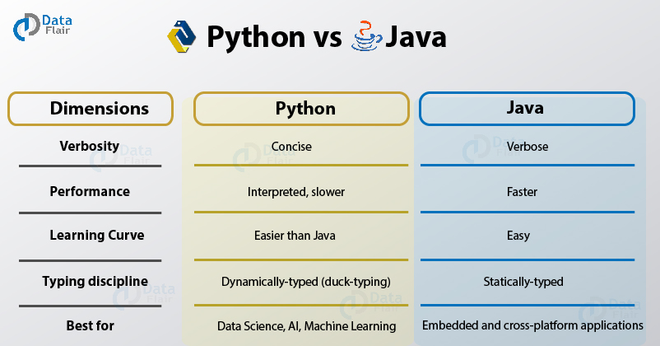
No. 1 vs No. 2

Slide 18
2
Natural Language Processing (NLP)

Slide 19

What will be covered?
What is Natural Language Processing?
Brief history of NLP
Fundamental Tasks in NLP
Some applications of NLP

Slide 20
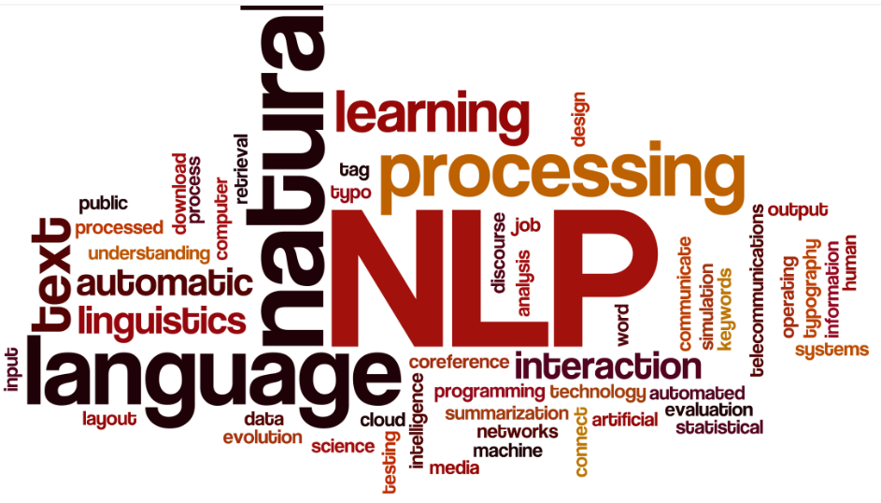
2.1. What is Natural Language Processing?
To get computers to perform useful tasks involving human languages
Notes:
Different time has different time‘s feature

Slide 21
Why should I learn NLP?
Answers on Quora:
https://www.quora.com/Why-should-I-learn-NLP
2 days NLP Level 1 Basic Workshop - Participants Interview:
https://youtu.be/UA17IVfArbU
Is it still worth learning NLP in the age of API-accessibles LLM like GPT?:
https://www.reddit.com/r/learnmachinelearning/comments/10c509n/is_it_still_worth_learning_nlp_in_the_age_of/
Notes:
NLP stands for Natural Language Processing. To understand what it is, let me break it down for you.
So, basically, NLP is understanding the language of your mind. It is used to understand the thoughts, feelings, emotions, opinions etc., of a person. And this study is used to give outputs that they would produce or results that is relevant
Well, we all know how Machine Learning and AI are emerging. We are surrounded by Smart Systems even without realizing it. Smartphones, online services, customer services, automation and many more. And NLP plays a major role in all of these. There's always an effort to make the user experience better, and providing a humane interface is working pretty well (You always see people excited to use services like Siri, Google Assistant etc.). And here's where chatbots come into the picture.
Working on a chatbot project would be really useful if you are interested in AI or Machine Learning and looking to make a Career in it. It would help you understand the basics and how you can implement what you can. And it would surely make a good impression to people hiring you.
Did you know that 80% of enterprise-generated data is unstructured data in the form of emails, online news, contracts, health records, voice transcripts etc, Only 20% of the data is organized in a tabular and organized form, Yet businesses, whether its finance, marketing, or healthcare spend most of their time analyzing the structured data and completely ignore the wealth of information that is buried in unstructured data.
NLP will allow you to create custom machine learning models to automatically extract and analyze information from your unstructured text. Therefore, harnessing unstructured data will give businesses a significant advantage. The NLP market is currently growing at 32% annual growth and is expected to reach a market cap of $29.5 B.

Slide 22
Why is NLP interesting
Languages involve many human activities
NLP is hard!
NLP is used to acquire insights from massive amount of textual data
NLP can interact with different languages and different linguistic structures easily
Voice can be used as a user interface in many applications

Slide 23
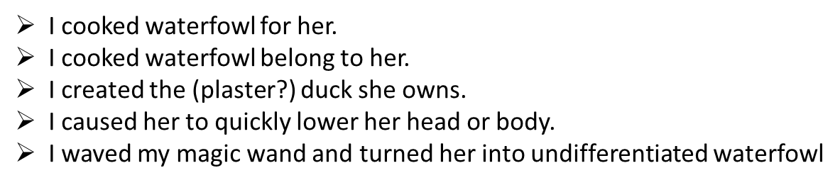

Why is NLP hard?
Highly ambiguous
I made her duck may have different meanings
Natural languages involve reasoning about the world
It is unlikely that an elephant wears a pajamas (sentence: I shot an elephant in pajamas).

Slide 24

2.2. Brief history of NLP
1957-1970s
Chomsky and others on formal language theory and generative syntax
1983-1993
Empiricism and Finite State Models Redux
2000-2018
Machine Learning and deep learning
1940s – 1950s
Automaton, Probabilistic/Information-Theoretic models
1970-1983
Explosion in research in speech and language processing
1994-1999
Probabilistic and data-driven models
2019-now
Large Language models
Notes:
1948, A Mathematical Theory of Communication

Slide 25
2.3. Fundamental Tasks in NLP
Part of speech tagging
Word segmentation
Syntactic analysis
Semantic analysis and sentiment analysis
Named entity recognition
Topic segmentation and recognition
Language translation

Slide 26

2.4. Some applications of NLP
IR & QA
Information Extraction
Text Summarization and Generation
Machine Translation

Slide 27
3
How to begin？

Slide 28
Good resources for reference
Python 3.12.5
https://www.python.org/downloads/release/python-3125/
10 Best Python Libraries for NLP in 2024 and their Use Cases
https://www.unite.ai/10-best-python-libraries-for-natural-language-processing/
Top 20 Python Libraries You Must Know In 2024
https://medium.com/@codingwinner/top-20-python-libraries-you-must-know-in-2024-e075c8e50ecf
Allennlp
https://github.com/allenai/allennlp
Hugging Face:
https://huggingface.co

Slide 29
All can be done in clouds (Recommended)
Google Colab https://colab.research.google.com/notebooks/welcome.ipynb
GitHub
https://github.com
PyCharm Version: PyCharm 2024.2
https://www.jetbrains.com/pycharm/whatsnew/

Slide 30
4
About the course

Slide 31
Goals and Learning Objectives
Master key concepts and components of NLP and linguistics.
Manipulate large corpora, explore linguistic models, and test empirical claims.
Design and implement applications that process, manage, and analyze text data.
Clean and preprocess raw text data using basic natural language processing techniques.
Demonstrate the ability of extracting and analyzing information from text data using Python Program.
Build robust systems to perform linguistic tasks with technological application.
Document and report on information processing and applications.

Slide 32
Materials—Textbook
Downey, Allen B. (2016). Think Python: How to Think Like a Computer Scientist, 2nd Edition. O’Reilly, ISBN-13: 978-1-491-93936-9. (Required)
Hapke, H., Howard, C., & Lane, H. (2021). Natural Language Processing in Action: Understanding, analyzing, and generating text with Python (2nd Edition). Simon and Schuster. (Required)
Tunstall, L., Von Werra, L., & Wolf, T. (2022). Natural language processing with transformers (Revised Edition). " O'Reilly Media, Inc.". (Required)

Slide 33
Grading
In-class exercise (20%) — 5 in-class exercises
Assignments (40%) — 4 assignments
Quizzes (10%) — 5 in-class quizzes
Term project (30%) — Group work
Extra credits (6%) — Reading and presentation;
Extra credits (3%, 1% / each time) — Attending research presentations in the department
Extra credits (1%) — Course evaluation
Attendance is mandatory to pass. Students who miss more than 3 times will be dropped with W or WF.
Cheating will not be tolerated. Using ChatGPT is allowed but remember that ChatGPT gives the same output for similar prompts provided by different users. Similarity in work would count towards plagiarism.
Late work without the permission of the instructor will receive a grade with a 10% penalty (or 10 points out of 100) per day after the due date.

Slide 34
About me
Ph.D., Assistant Professor, Data Science
10-year experience in python and data analytics
Machine learning, natural language processing, information retrieval, and text mining
Reviewer of more than 30 peer-review journals and 20 international conferences
A good friend who is willing to connect with our master students

Slide 35
About me
Publications
Lab: https://idealabunt.github.io/home/index.html
Google Scholar: https://scholar.google.com/citations?user=URmnWAQAAAAJ&hl=en&oi=ao
Research Gate: https://www.researchgate.net/profile/Haihua-Chen-2
GitHub: https://github.com

Slide 36
About me
Email: haihua.chen@unt.edu
Cell Phone: 9402688589
Office: DP E298A
Office hour: By appointment
Zoom ID: 247 728 2245

Slide 37
Teaching Assistant
Fengjiao Tu, PhD student in Information Science (Data Science Concentration), Department of Information Science, University of North Texas
Yuhan Zhou, PhD student in Information Science (Data Science Concentration), Department of Information Science, University of North Texas
Office hours: DP E292J, Monday - Friday 12:00 PM – 2:00 PM
Email address: fengjiaotu@my.unt.edu, yuhanzhou@my.unt.edu

Slide 38
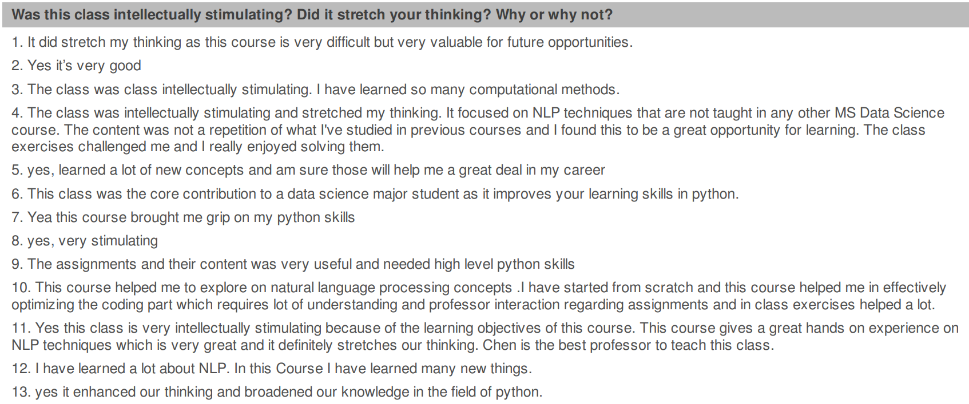
Feedbacks from Previous Students

Slide 39
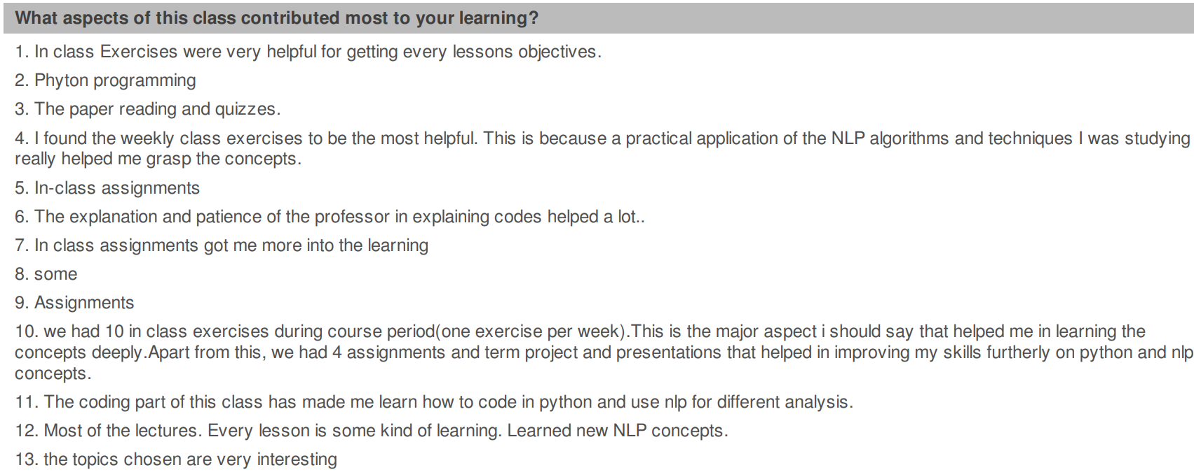
Feedbacks from Previous Students

Slide 40
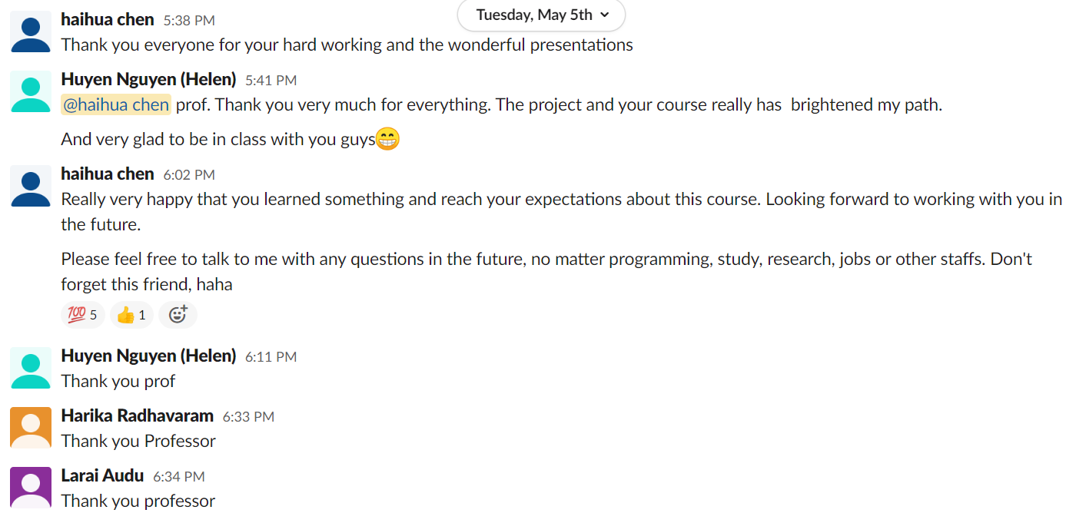
Feedbacks from Previous Students

Slide 41
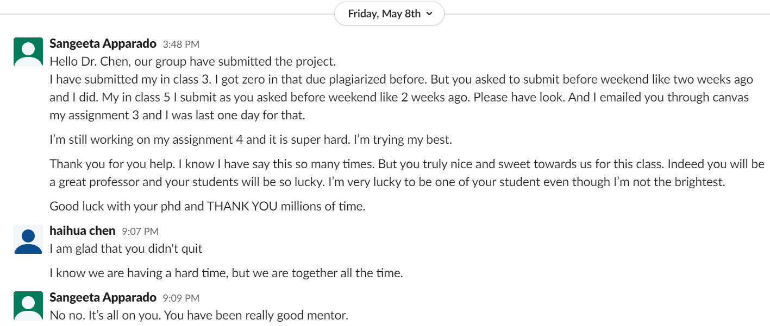
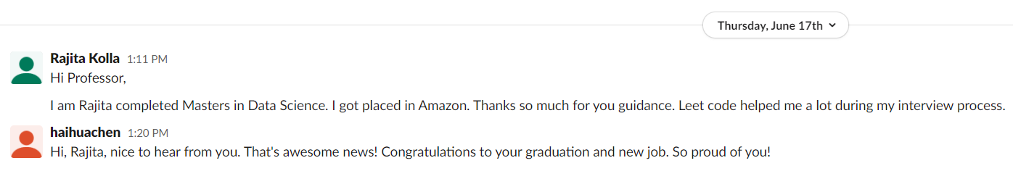
Feedbacks from Previous Students

Slide 42
Thank you

